Slide 1

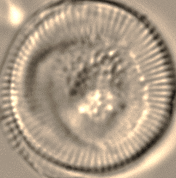
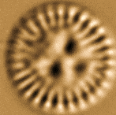
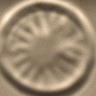
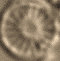
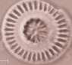
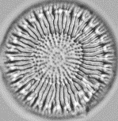
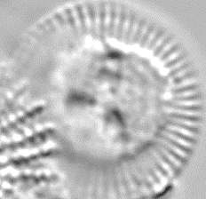
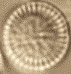
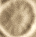
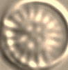

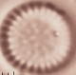
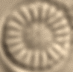

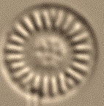

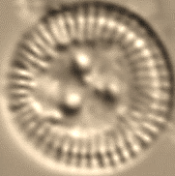
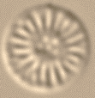


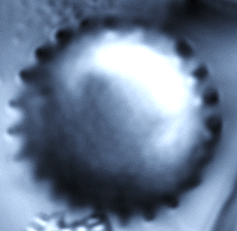

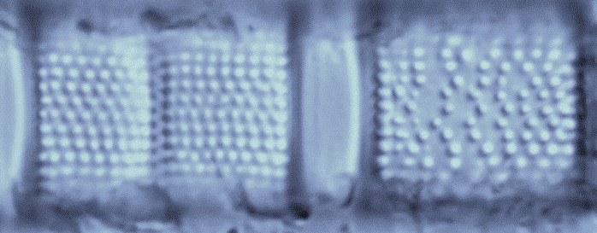
Great Slave Lake: diatom response to warming
Shorter
Increased thermal stability
GSL12 sediment core
Planktonic diatoms favoured
Aulacoseira islandica
Cyclotella (s.l.)
A. formosa/F. tenera
0
~1995
2
Strongly mixed water column
4
21st century accelerated warming
ICE-COVER DURATION
6
8
Aulacoseira taxa prevail
10
12
Extensively ice-covered
~1800
14
16
Diatoms scarce but well-preserved
Diatom growth inhibited
18
Longer
20
40
20
40
60
80
% Relative Abundance
Rühland et al. 2023
Proceedings of the Royal Society B
Notes:
Simplified schematic diagram illustrating the effects of warmer conditions and longer ice-free periods on diatom assemblage composition in Great Slave Lake sediment records. Cooler conditions with longer ice-cover and a well-mixed water column favoured heavier, large-celled diatoms such as Aulacoseira islandica. Warmer conditions, longer ice-free periods, declines in wind speed and accelerated warming, particularly since the turn of the 21st century, led to reduced turbulent mixing, longer and stronger periods of thermal stratification, and associated changes in light availability that favoured small-celled planktonic diatoms such as Cyclotella sensu lato (s.l.) taxa.

